Slide 1
AI CHATBOT
SUBMITTED BY:
SRISHTI SINGH(RA2011003010122)
YUKTA KASINA(RA2011003010118)

Slide 2
ABSTRACT
The main aim and objective of this project is to build a AI Chatbot for Cyber Security Industry. We can see chatbots are being encouraged and adopted by many of the industries and universities like “Make my Trip”, “Lovely Professional University”, etc. In project we tried to build a chatbot focused for Cyber Security industry and trained it in such a way that other than the company Information it can also entertain some of the basic security quires.

Slide 3
INTRODUCTION
Chatbots are basically AI intelligence bots which can interact with the user or customers depends upon the usage. It is an application of Artificial Intelligence and Machine Learning­. Now-a-days technology is increasing rapidly. In this technological world every industry is trying to automate things to provide better services. One of the great application of automation would be chatbot.
There are basically two types of Chatbots :

Slide 4
Command based: Chatbots that function on predefined rules and can answer to only limited queries or questions. Users need to select an option to determine their next step.
Intelligent/AI Chatbots: Chatbots that leverage Machine Learning and Natural Language Understanding to understand the user’s language and are intelligent enough to learn from conversations with their users. You can converse via text, speech or even interact with a chatbot using graphical interfaces.
Here in this project we created an AI Chatbot which is focused for Cyber Security Industry and trying to solve of the use cases of industry by training it in such a way that it can answer some of the basics queries of cyber security as well other than just the customer services.

Slide 5
METHODOLOGY
The methodology that we used for this application is very simple. We used the concept of Natural Language Processing and building our own Neural network by using tflearn. We have used a json file “intents.json” for training our model. The intents.json is the file which consists of some sample chats and each chat block under a “tag”.
This intents file is being created by our team. We have provided some basic chats regarding the Cyber Industry and some basics terminologies and some basic queries related to Cyber Security.
We used this file for training the model and the model is being trained by using fit() method of tflearn and saved the model as “model.tflearn”. All the trained data is being stored in a file named “training_data” and further this file is used for giving response.

Slide 6
ALGORITHM
Step 1. Install the Chatterbot and chatterbot_corpus module :
Run the following pip commands on the terminal for installation:
Step 2. Import the modules
We have to import two classes: ChatBot from chatterbot and ListTrainer from chatterbot.trainers
pip install chatterbot
pip install chatterbot_corpus
from chatterbot import ChatBot
from chatterbot.trainers import ListTrainer

Slide 7
Step 3. Name our Chatbot:
Now, we will give any name to the chatbot of our choice. Just create a Chatbot object. Here the chatbot is maned as “Bot” just to make it understandable.
Step 4. Use of Logic Adapter:
The Logical Adapter regulates the logic behind the chatterbot that is, it picks responses for any input provided to it.
Step 5. Training, Communication, and Testing :
You have to execute the following commands now:
bot = ChatBot('Bot’)
chatbot = ChatBot(
'JARVIS',
logic_adapters=[
'chatterbot.logic.BestMatch',
'chatterbot.logic.TimeLogicAdapter'],
)

Slide 8
from chatterbot.trainers import ListTrainer
trainer = ListTrainer(bot)
trainer.train([
'Hi',
'Hello',
'I need roadmap for Competitive Programming',
'Just create an account on GFG and start',
'I have a query.',
'Please elaborate, your
concern',
'How long it will take to become expert in Coding ?',
'It usually depends on the amount of practice.',
'Ok Thanks',
'No Problem! Have a Good Day!'
])
Now let, test the chatbot:
response = bot.get_response("Good morning!")
print(response)

Slide 9
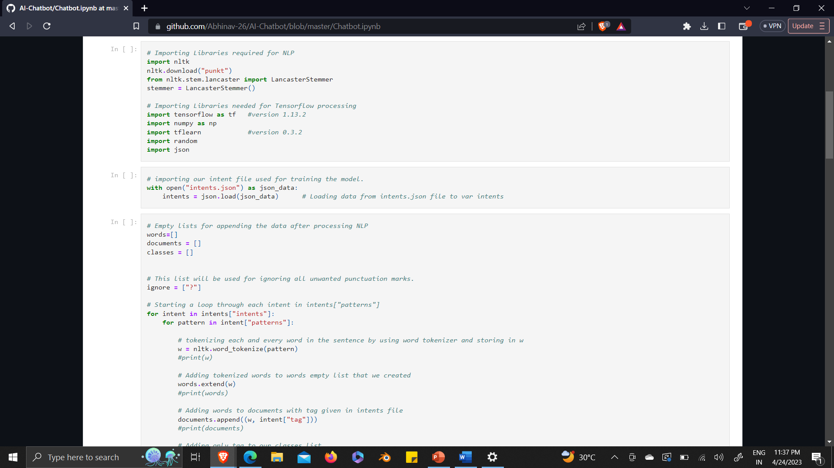
CODE

Slide 10
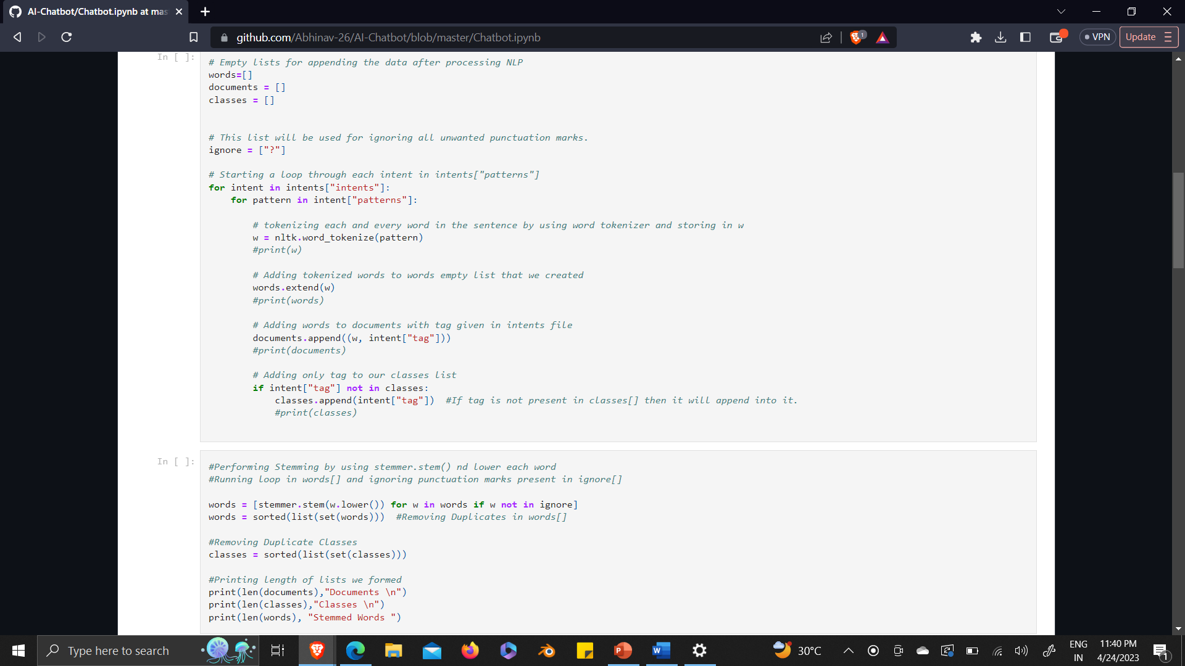

Slide 11
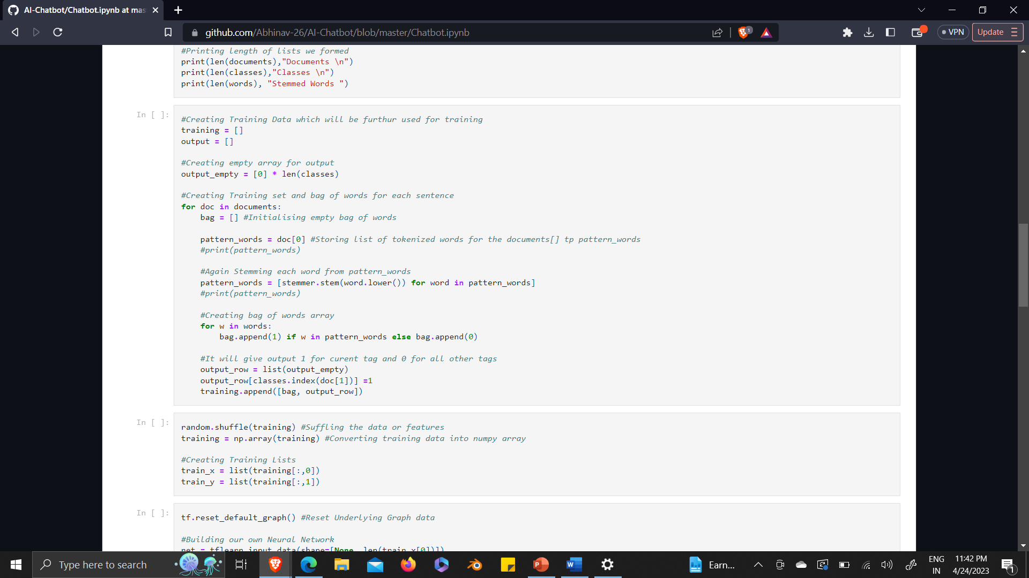

Slide 12
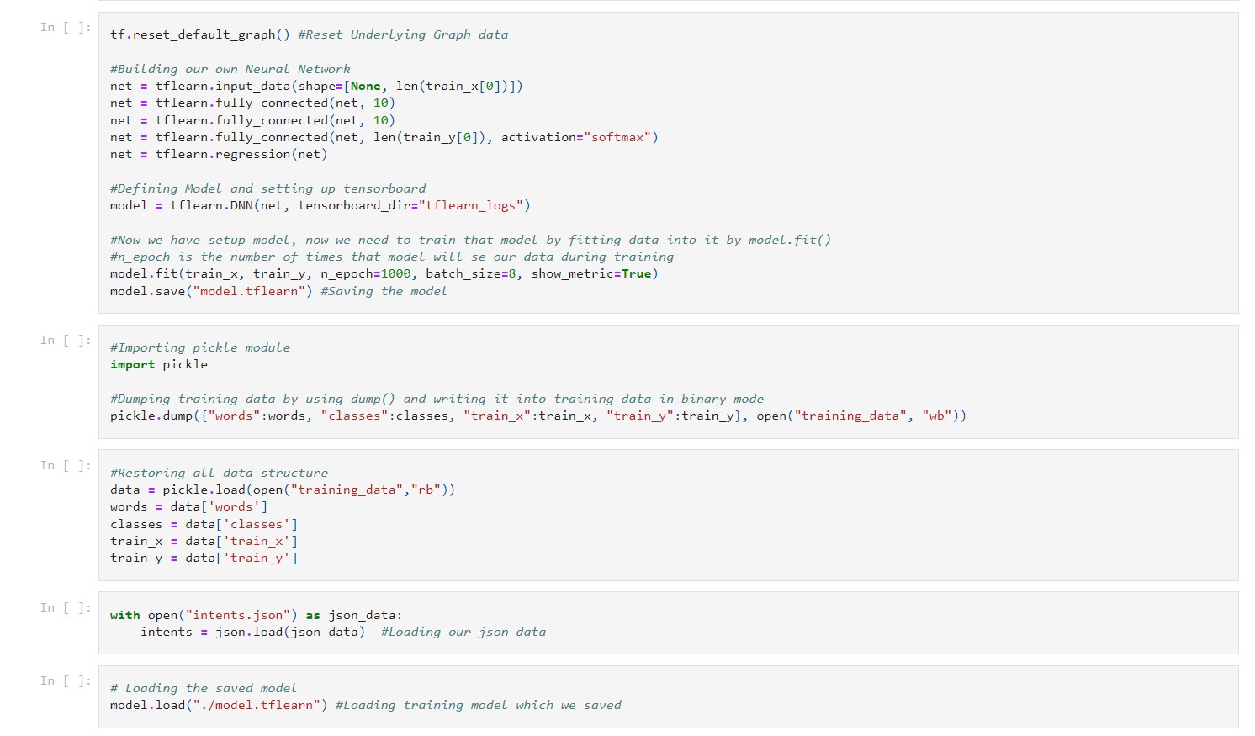

Slide 13
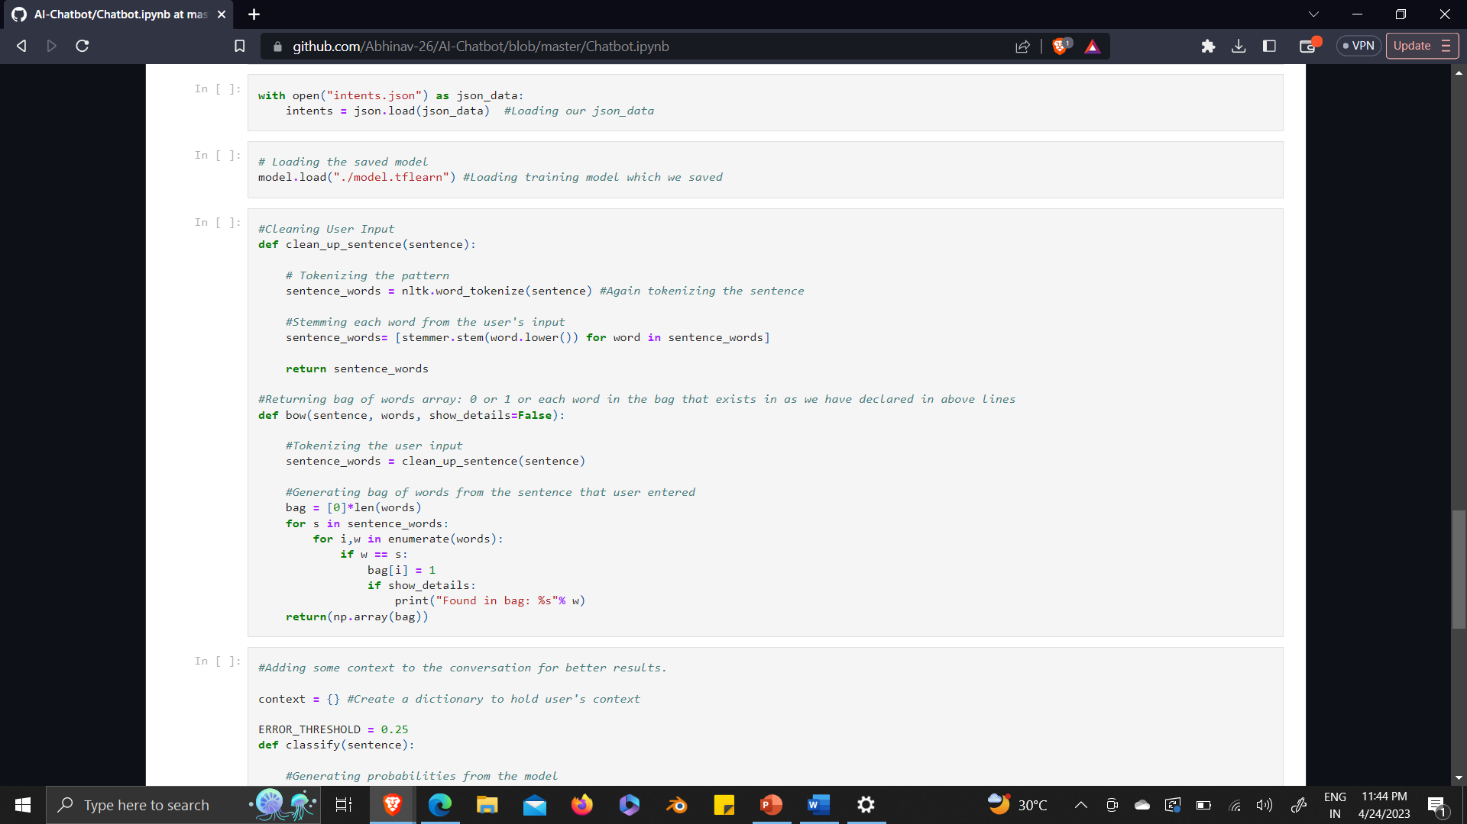

Slide 14
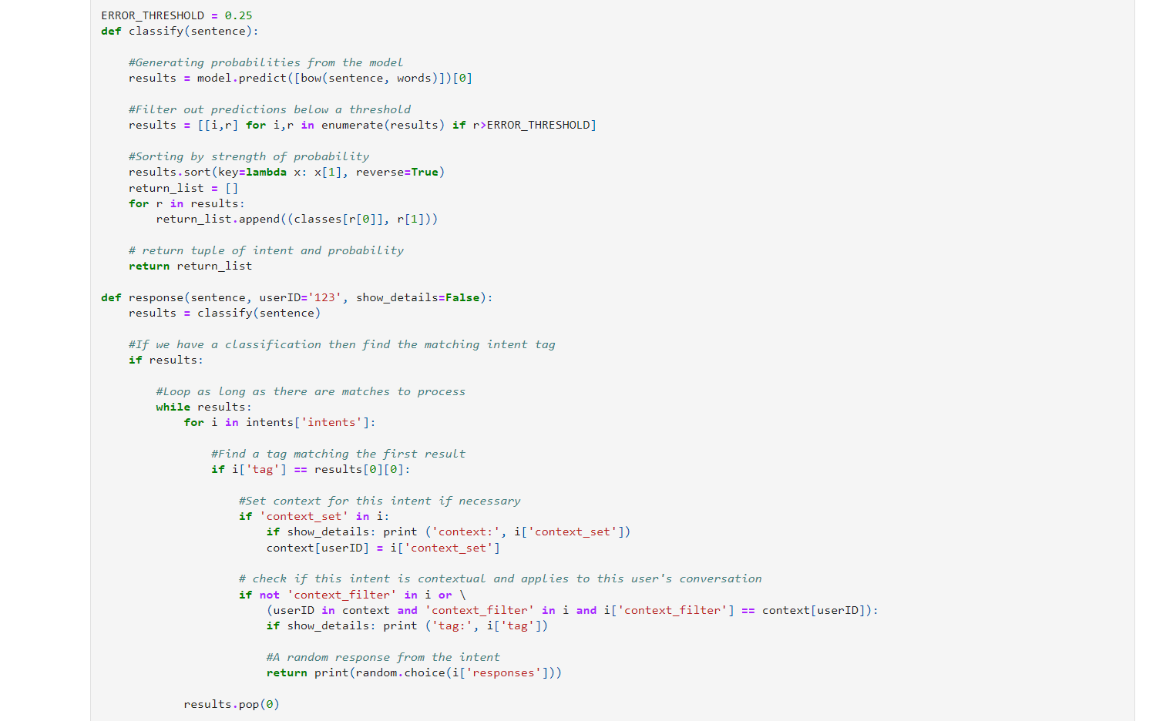

Slide 15
THANK YOU!

